Slide 1
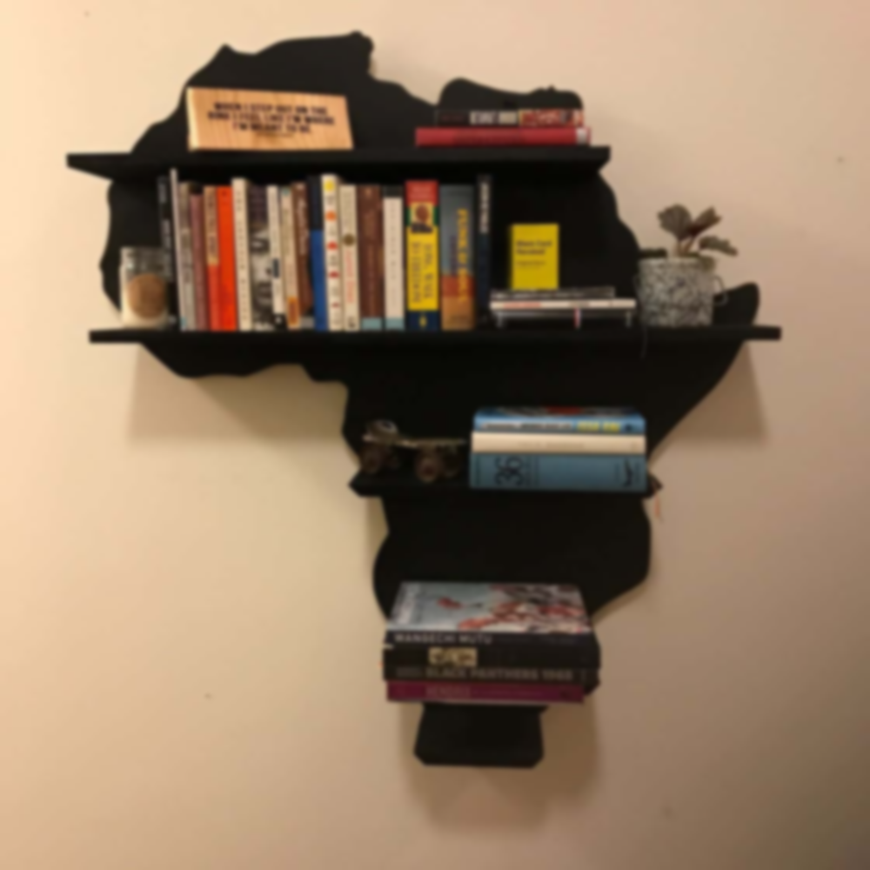
WELCOME TO OUR LIBRARY WEBSITE PRESENTATION
MADE BY:
BERNADO NJOGA
ABDUL IDRISS
COORDINATORS:
MR KAMBANG SINCLAIRE & Mr MUA WALLACE

Slide 2
STEPS
INTRODUCTION
WOKDONE
DEMO
CHALLENGES ENCOUNTERED
CONCLUSION
REMARKS
QUESTIONS
1
2
3
4
5
6
7

Slide 3
WOKDONE
1
2
3
HTML CSS and JavaScript
Which are used for the structuring, the styling and animations of a web page
GOOGLE FONTS
Which is a site where you
Have the possibility to have different fonts
Coolors.co
Which is a website which you can use for different colour palettes
4
Fontawesome
Which is a website in which you have access and to different logos

Slide 4

3
5

Slide 5

CHALLENGE ENCOUNTERED
1
2
FINDING DIFFERENT BOOKS
Debugging (fixing the code crash )
3
Writing the code and
doesn’t work
as desired

Slide 6
Conclusion and Remarks We encountered many challenges, it was interesting, instructive and some parts was frustrating Thought it was still amusing and fun Better features are still to come with our future work Thanks to our Coordinators Mr Kambang Sinclaire and Mr Mua Wallace.

Slide 7
QUESTIONS ?

